Slide 1
Characteristics of CVI
CVI Training for Effective Teaching of Students with Visual Impairments
Characteristics of CVI
CViConnect
Stephanie Steffer
stephanies@cviconnect.co

Slide 2


Understanding CVI
Learning Objectives:
  Participants will be able to identify the 10 Characteristics of CVI

Slide 3
10 Characteristics of CVI (pg1)
Understanding CVI
Color preference
Need for movement
Visual latency
Visual field preference
  Dorsal Stream Vision
  Ventral Stream Vision
Visual and Behavioral CVI Characteristics from Roman-Lantzy
CVI Characteristics from Roman-Lantzy

Slide 4
10 Characteristics of CVI (pg2)
Understanding CVI
Difficulty with visual complexity
Complexity of Objects
Visual and Behavioral CVI Characteristics from Roman-Lantzy
CVI Characteristics from Roman-Lantzy

Slide 5


Examples of complexity of the target

Slide 6
10 Characteristics of CVI (pg3)
Understanding CVI
Difficulty with visual complexity
Complexity of Objects
Complexity or Array
Visual and Behavioral CVI Characteristics from Roman-Lantzy
CVI Characteristics from Roman-Lantzy

Slide 7

Testing your Awareness

Slide 8
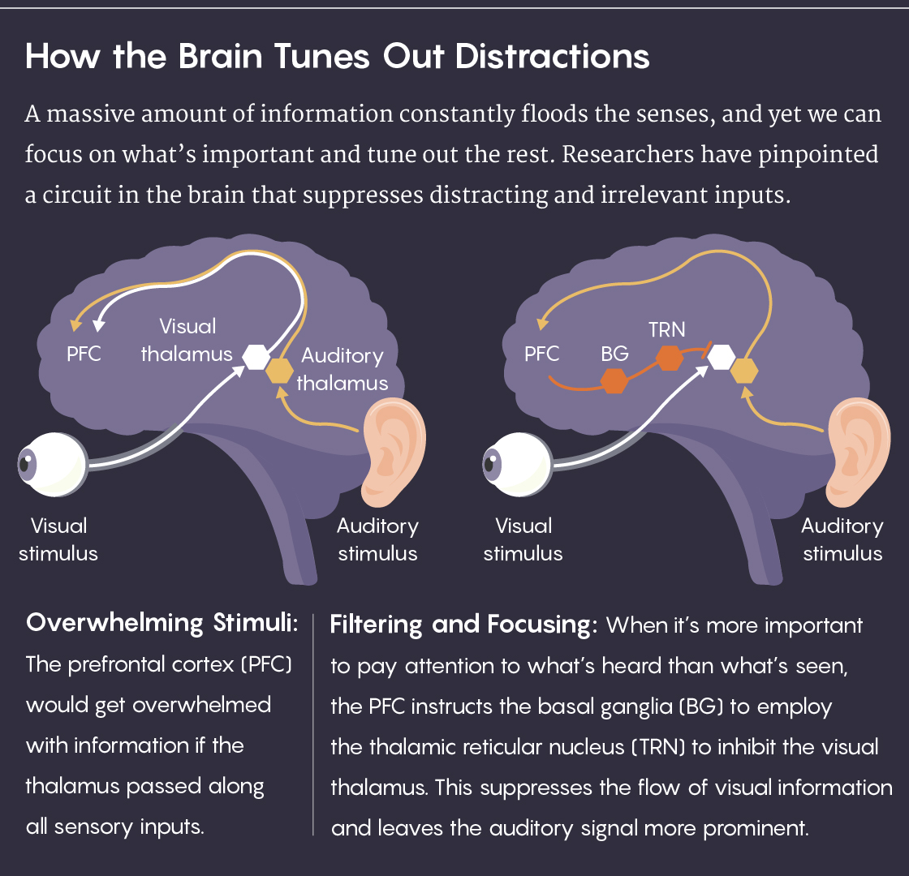
How the Brain Tunes Out Distractions
Research from Michael Halassa

Slide 9

Example of complexity of the array
Caption

Slide 10
Example of complexity of the array pg2
Caption

Slide 11
10 Characteristics of CVI (pg4)
Understanding CVI
Difficulty with visual complexity
Complexity of Objects
Complexity or Array
Complexity of Faces
  Complexity of Sensory Environment
Visual and Behavioral CVI Characteristics from Roman-Lantzy
CVI Characteristics from Roman-Lantzy

Slide 12
10 Characteristics of CVI (pg5)
Understanding CVI
Need for light
Difficulty with distance Viewing
Visual and Behavioral CVI Characteristics from Roman-Lantzy
CVI Characteristics from Roman-Lantzy

Slide 13
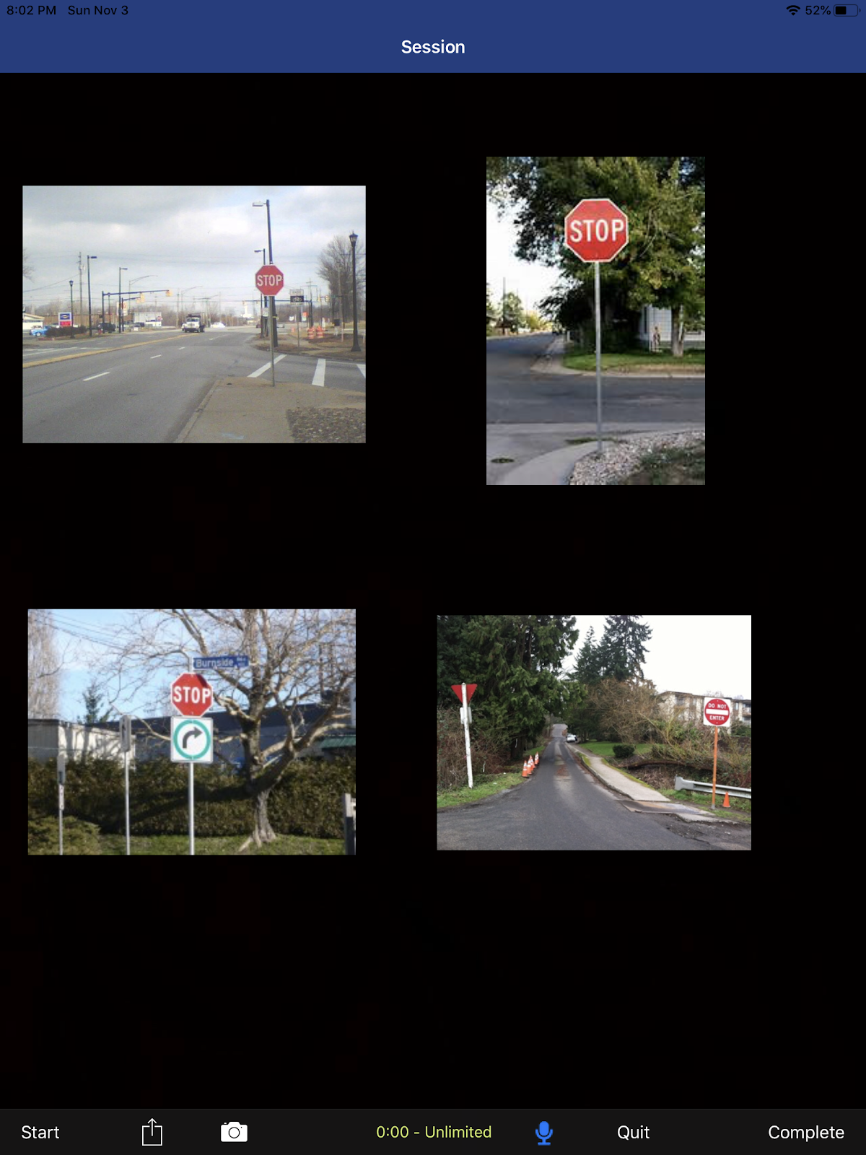
Example of Distance

Slide 14
10 Characteristics of CVI
Understanding CVI
Need for light
Difficulty with distance Viewing
This is the only characteristic that will not require an accommodation.
Atypical visual reflexes
Difficulty with visual novelty
Absence of visually guided reach
Visual and Behavioral CVI Characteristics from Roman-Lantzy
CVI Characteristics from Roman-Lantzy

Slide 15
10 Visual and Behavioral Characteristics of CVI
Color Preference
Need for Light
Need for Movement
Difficulty with Distance Viewing
Visual Latency
Atypical Visual Reflexes
Visual Field Preference
Difficulty with Visual Novelty
Difficulty with Visual Complexity
Absence of Visually Guided Reach
Visual and Behavioral CVI Characteristics from Roman-Lantzy

